Slide 1
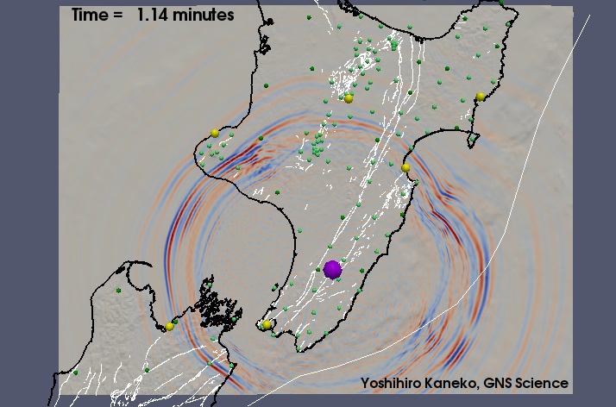
Seismic wavefield simulations of earthquakes in North Island of New Zealand
Yoshihiro Kaneko, GNS Science
Collaborators:
Carl Tape, U. of Alaska – Fairbanks
John Ristau, GNS Science

Slide 2
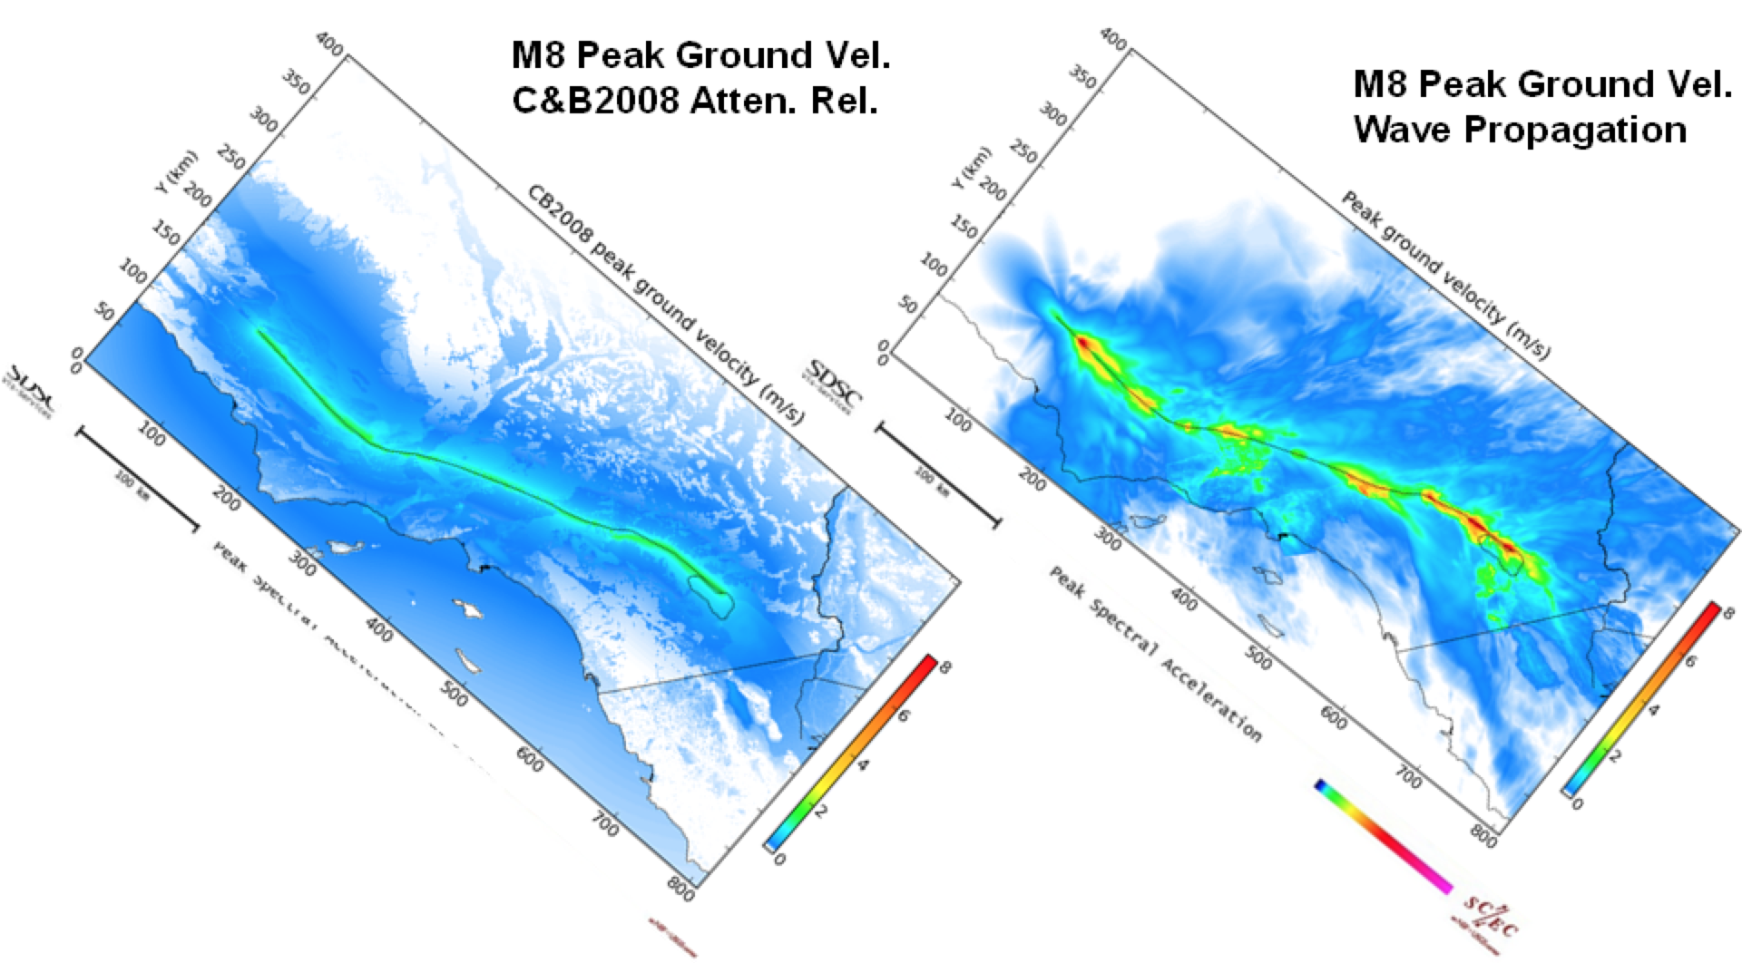
Motivation
Deterministic simulations of seismic wave propagation is a promising approach for probabilistic seismic hazard analysis (PSHA)
Scenario earthquake modeling provides insights into source parameters controlling strong ground motion (e.g., in preparation for a potential M9 Hikurangi earthquake)
Ground motion = source + path (+ site)
An accurate and high-resolution velocity model is essential
GMPE
LA basin
(Graves et al., 2010)
Objective
Validate the 3D velocity model of North Island; perform full wavefield simulations of earthquakes (4.0<M<5.5) using SPECFEM3D and quantify travel-time misfits between data and synthetics

Slide 3
Motivation
Deterministic simulations of seismic wave propagation is a promising approach for probabilistic seismic hazard analysis (PSHA)
Scenario earthquake modeling provides insights into source parameters controlling strong ground motion (e.g., in preparation for a potential M9 Hikurangi earthquake)
Ground motion = source + path (+ site)
An accurate and high-resolution velocity model is essential
GMPE
LA basin
(Graves et al., 2010)
Objective
Validate the 3D velocity model of North Island; perform full wavefield simulations of earthquakes (4.0<M<5.5) using SPECFEM3D and quantify travel-time misfits between data and synthetics

Slide 4
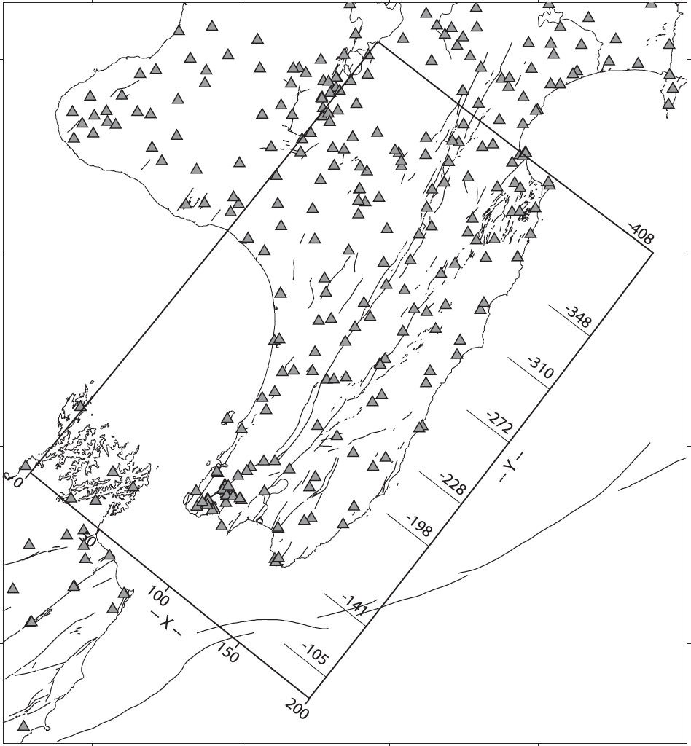
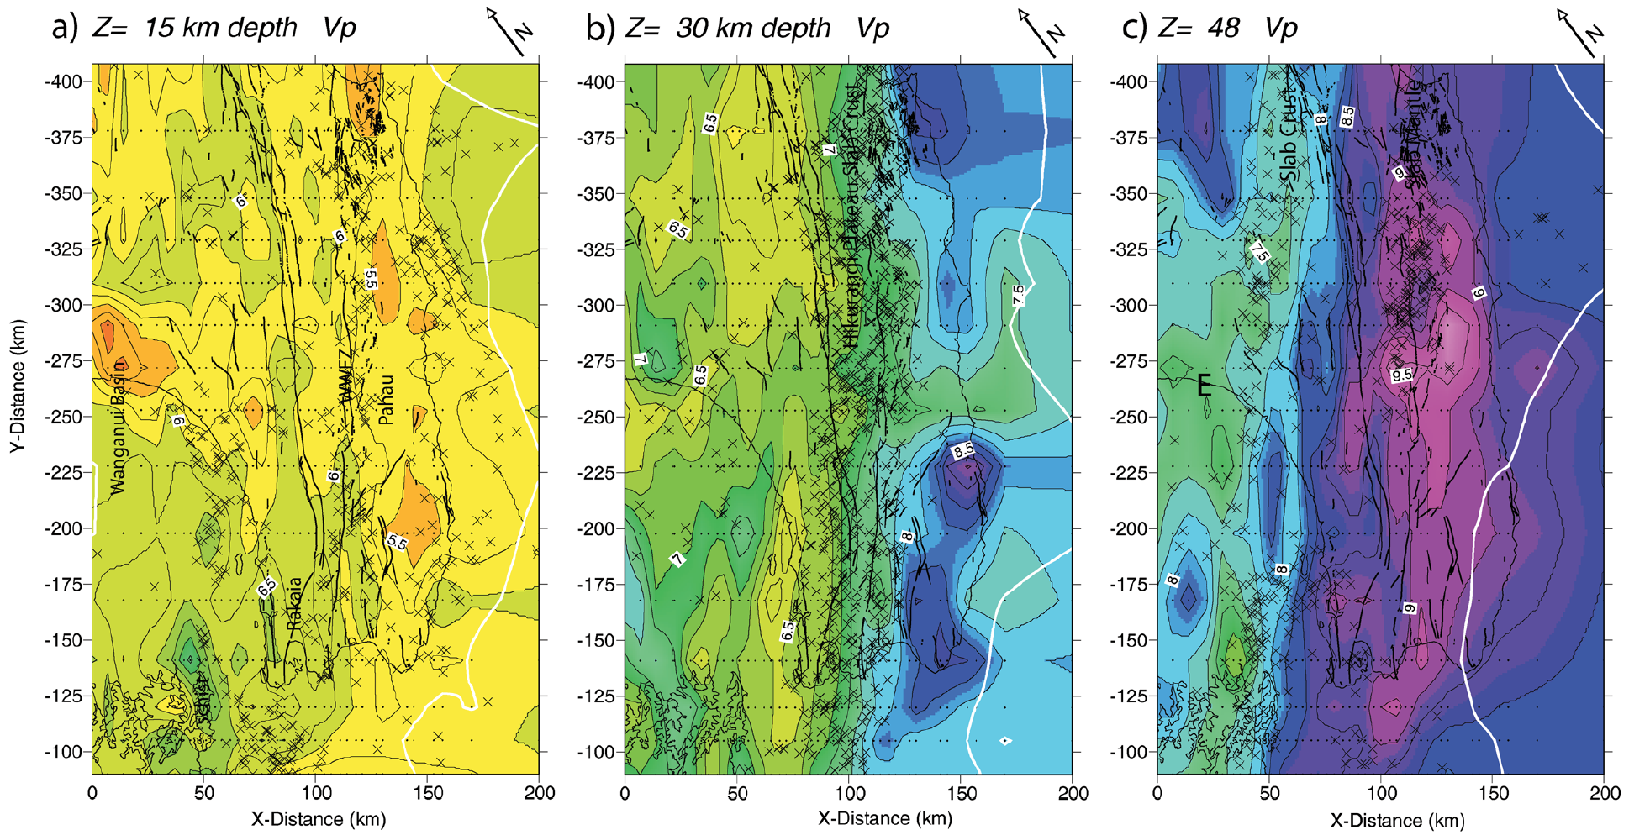
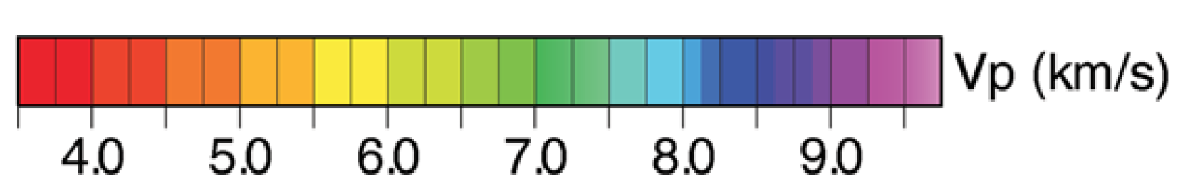
3D velocity model of North Island
Body-wave tomography, inverting for Vp and Vp/Vs
Ray theory (infinite frequency approximation -
all the sensitivity of the wave is confined to the ray)
High-velocity subducted slab
Low-velocity zone above the slab
Sedimentary basin (e.g., Wanganui)
Some small-scale patchy anomalies are artifacts
(Eberhart-Phillips et al., 2010; 2012)

Slide 5
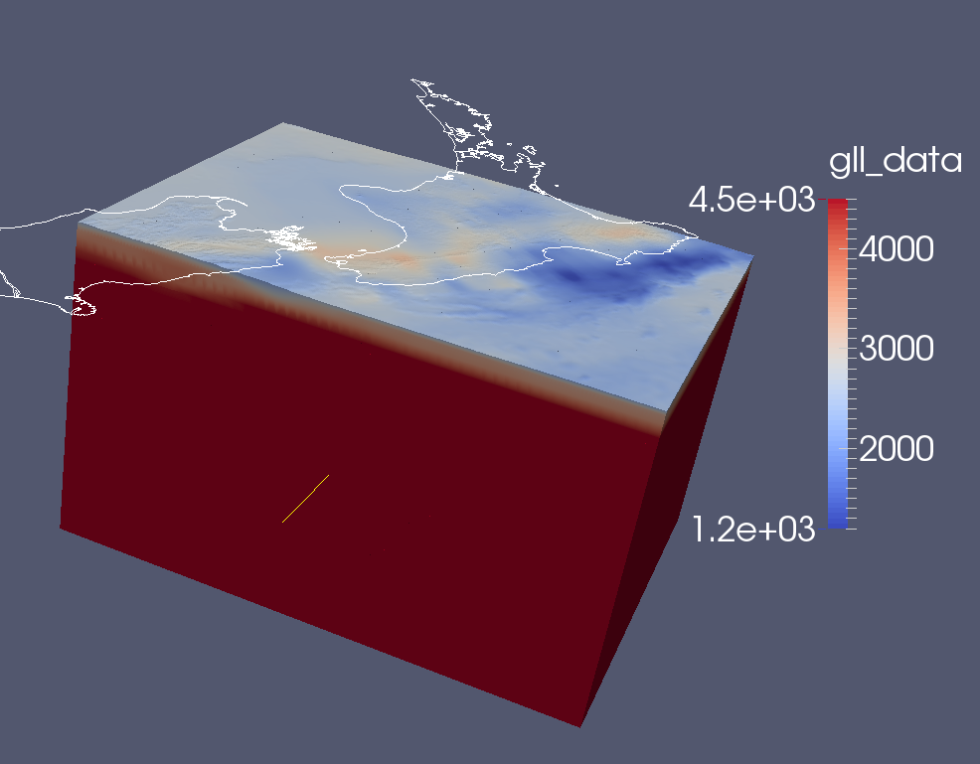
Finite element mesh
Vs (m/s)
3D velocity model (Eberhart-Phillips et al., 2010; 2012); no attenuation so far.
Topography and bathymetry
Element size of 1.4 km on the surface, 350 m average node spacing; coarser mesh at greater depths
Total of ~70 million node points; one simulation takes ~1 h using 144 cores on NeSI
Simulated waves are accurate down to 2.5 s

Slide 6
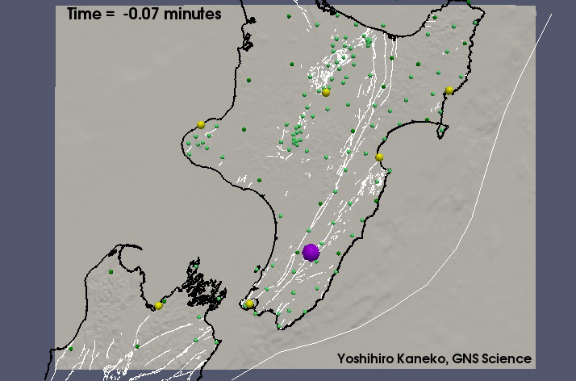
Full wavefield simulation movie
2014 M6.2 Eketahuna EQ (normal faulting event at depth of 25 km)

Slide 7
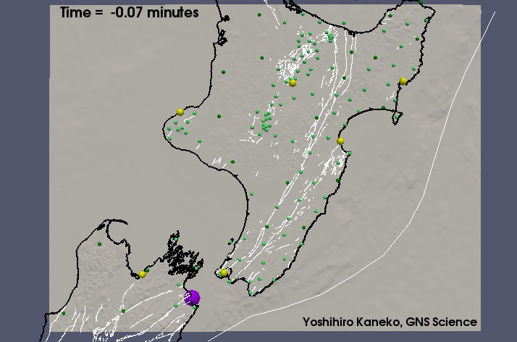
Full wavefield simulation movie
2013 M6.5 Cook Strait EQ (strike-slip event at depth of 12 km)

Slide 8
GeoNet stations
92 short-period stations
28 broadband stations
7 M~5 events recorded at broadband and short-period stations
Waveforms recorded at short-period stations are noisier for longer periods (T>4 s)
Use broadband stations only in this study

Slide 9
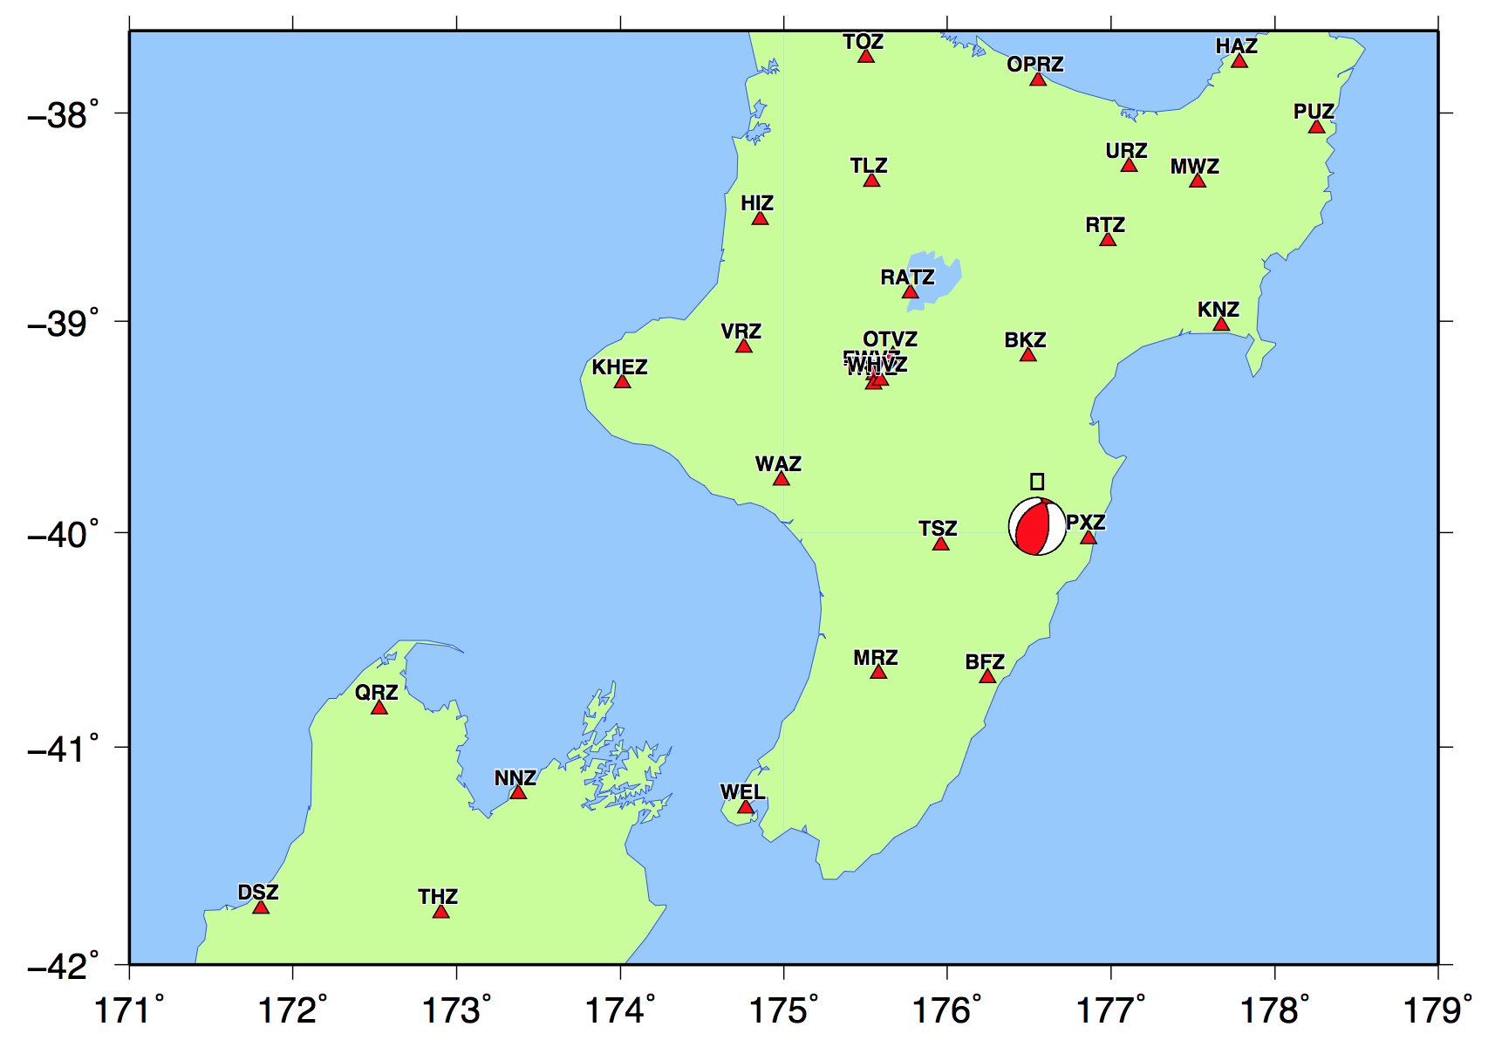
Comparisons between data and synthetics using a M5.1 event
3-component displ. seismograms;
Data – black; Synthetics – red;
Filter: 6 – 30 s
Complexity in data is not captured by the 3D model
1D synthetics do not fit data well

Slide 10
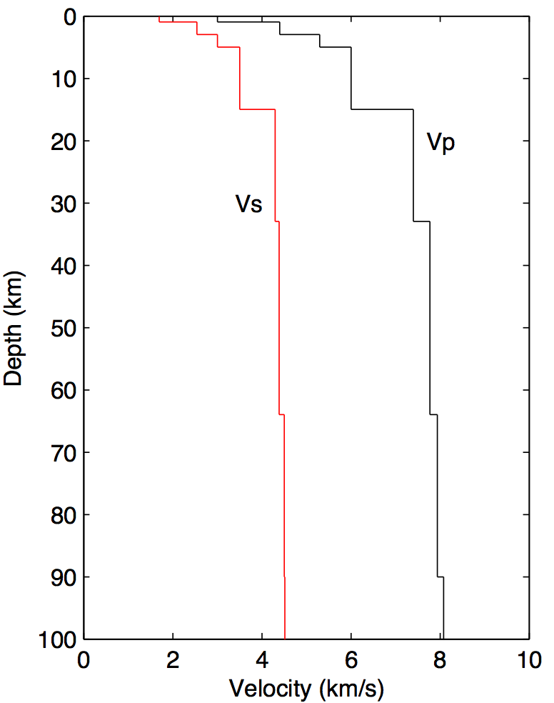
Comparisons between data and synthetics using a M5.1 event
1D model of North Island (Ristau, 2008)
3-component displ. seismograms;
Data – black; Synthetics – red;
Filter: 6 – 30 s
Complexity in data is not captured by the 3D model
1D synthetics do not fit data well

Slide 11
Comparisons between data and synthetics using a M5.1 event
3-component displ. seismograms;
Data – black; Synthetics – red;
Filter: 6 – 30 s
Complexity in data is not captured by the 3D model
1D synthetics do not fit data well

Slide 12
Comparisons between data and synthetics using a M5.1 event
3-component displ. seismograms;
Data – black; Synthetics – red;
Filter: 6 – 30 s

Slide 13
Comparisons between data and synthetics using a M5.1 event
3-component displ. seismograms;
Data – black; Synthetics – red;
Filter: 6 – 30 s
The 3D model appears to be faster than the real structure

Slide 14
Comparisons between data and synthetics using a M5.1 event
3-component displ. seismograms;
Data – black; Synthetics – red;
Filter: 6 – 30 s
The 3D model appears to be faster than the real structure

Slide 15
Comparisons between data and synthetics using a M5.1 event
3-component displ. seismograms;
Data – black; Synthetics – red;
Filter: 6 – 30 s
The 3D model appears to be faster than the real structure

Slide 16
Higher frequency waves are more difficult to be modeled

Slide 17
Higher frequency waves are more difficult to be modeled

Slide 18
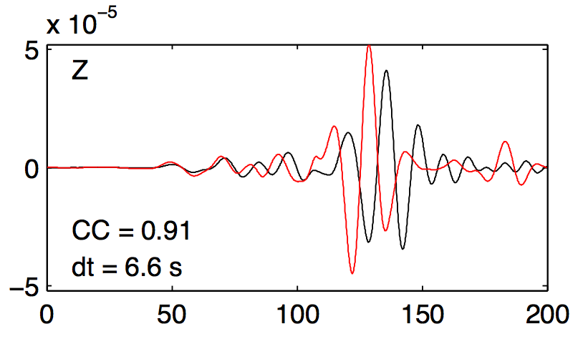
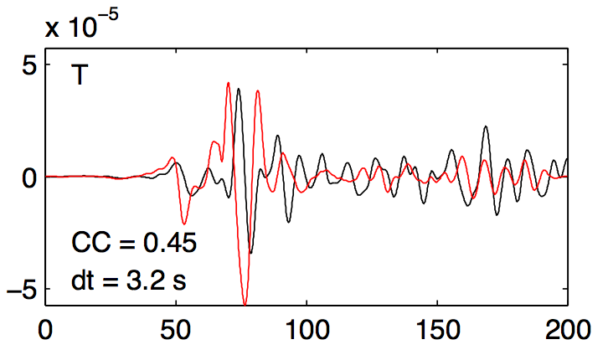
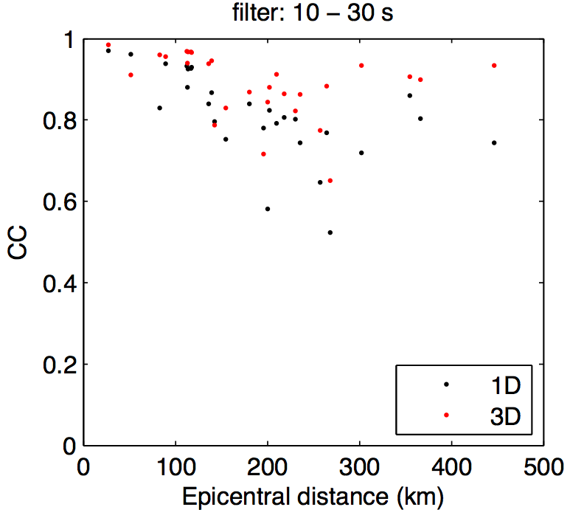
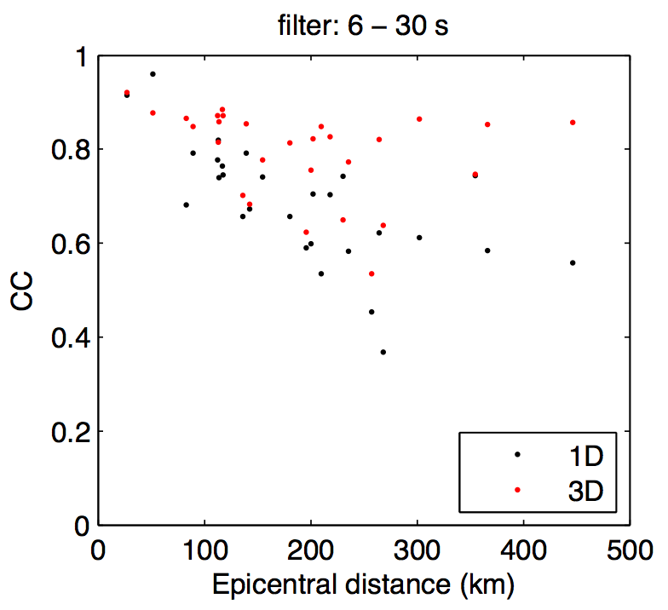
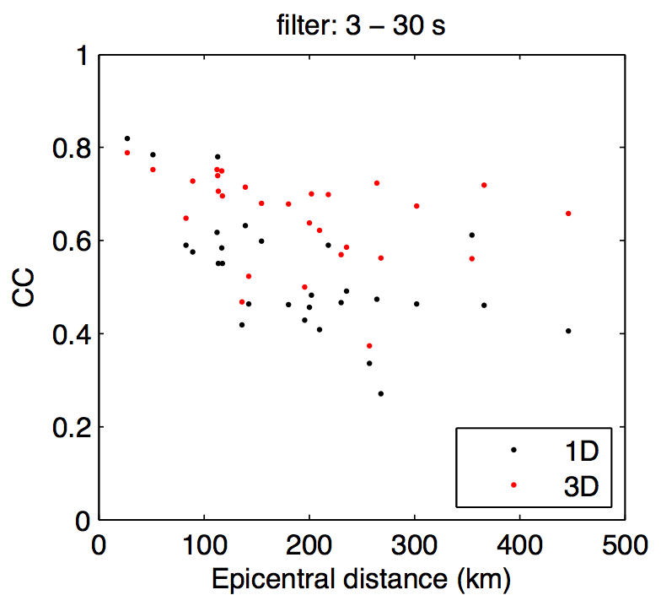
Quantitative validation
Measure travel-time phase delay and cross-correlation coefficient (CC)
Example: high CC
Example: low CC

Slide 19
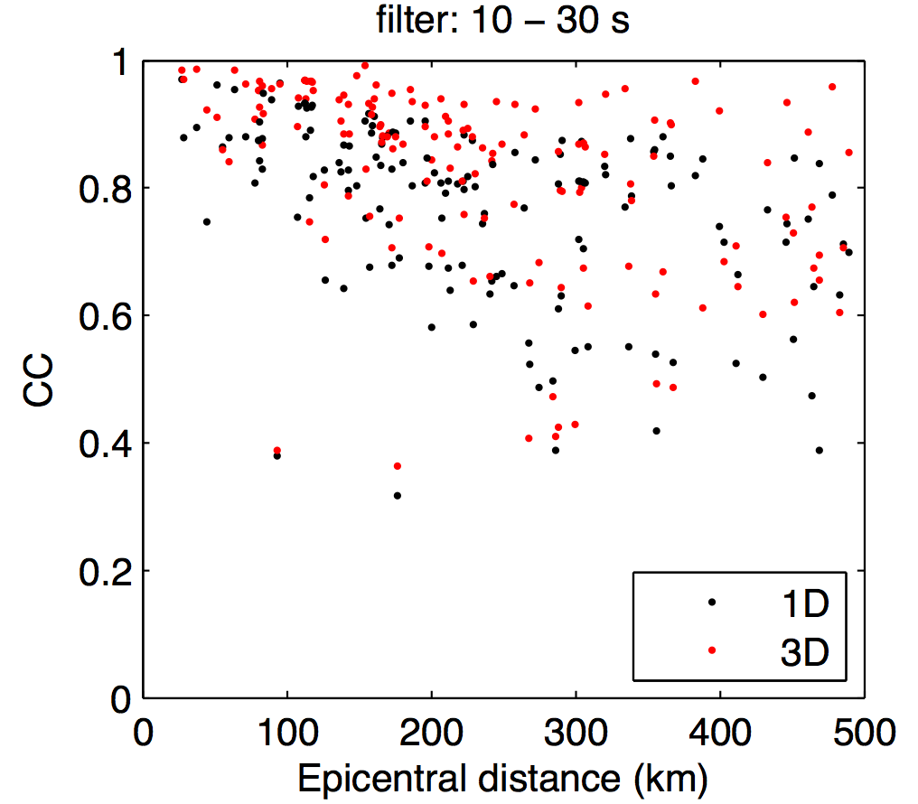
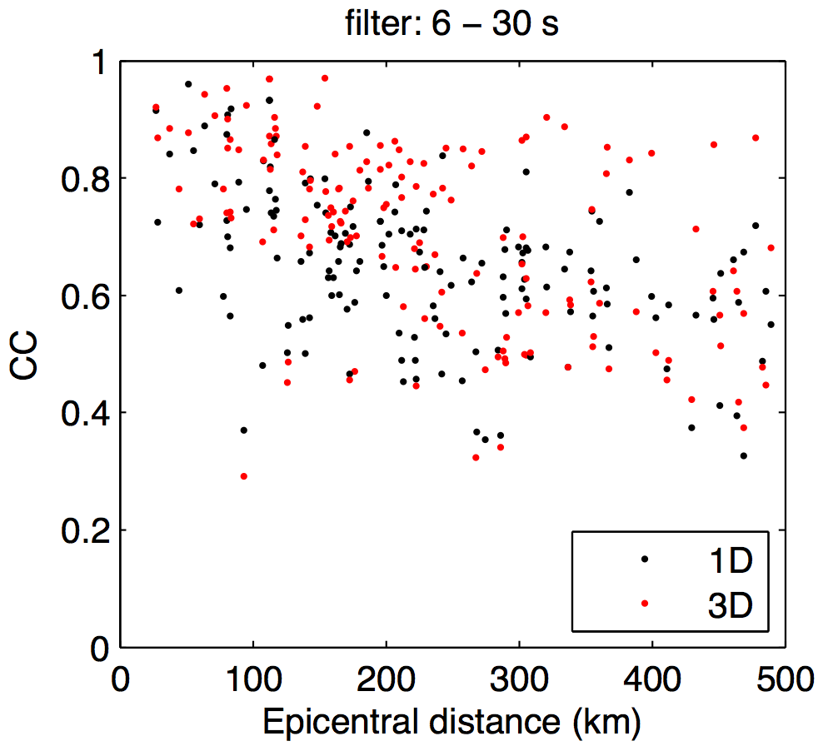
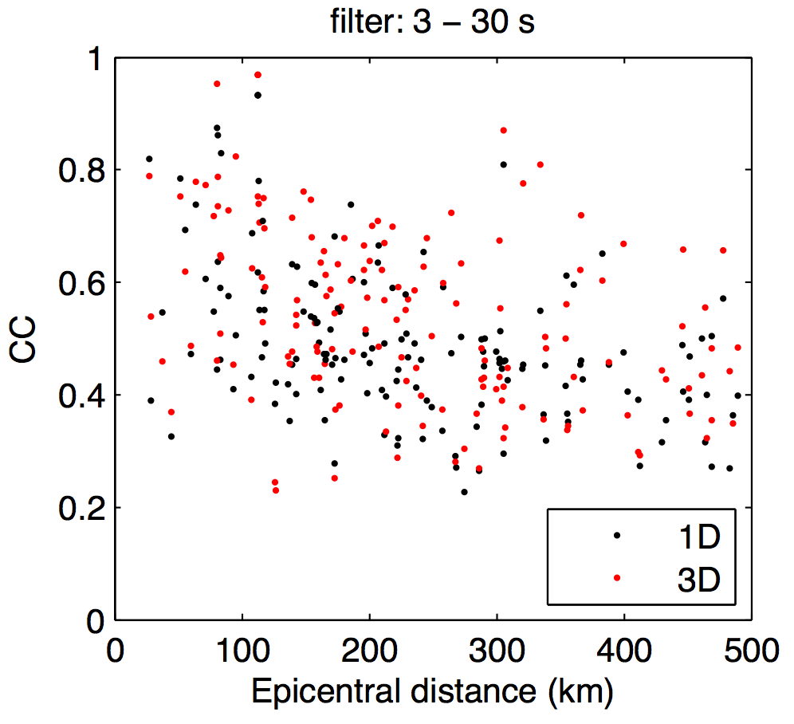
Quantitative validation
Measure travel-time phase delay and cross-correlation coefficient (CC)
Example: high CC
Example: low CC
CC are larger for the 3D model CC are smaller for high-frequency waves

Slide 20
Quantitative validation
Measure travel-time phase delay and cross-correlation coefficient (CC)
Example: high CC
Example: low CC
CC are larger for the 3D model CC are smaller for high-frequency waves

Slide 21
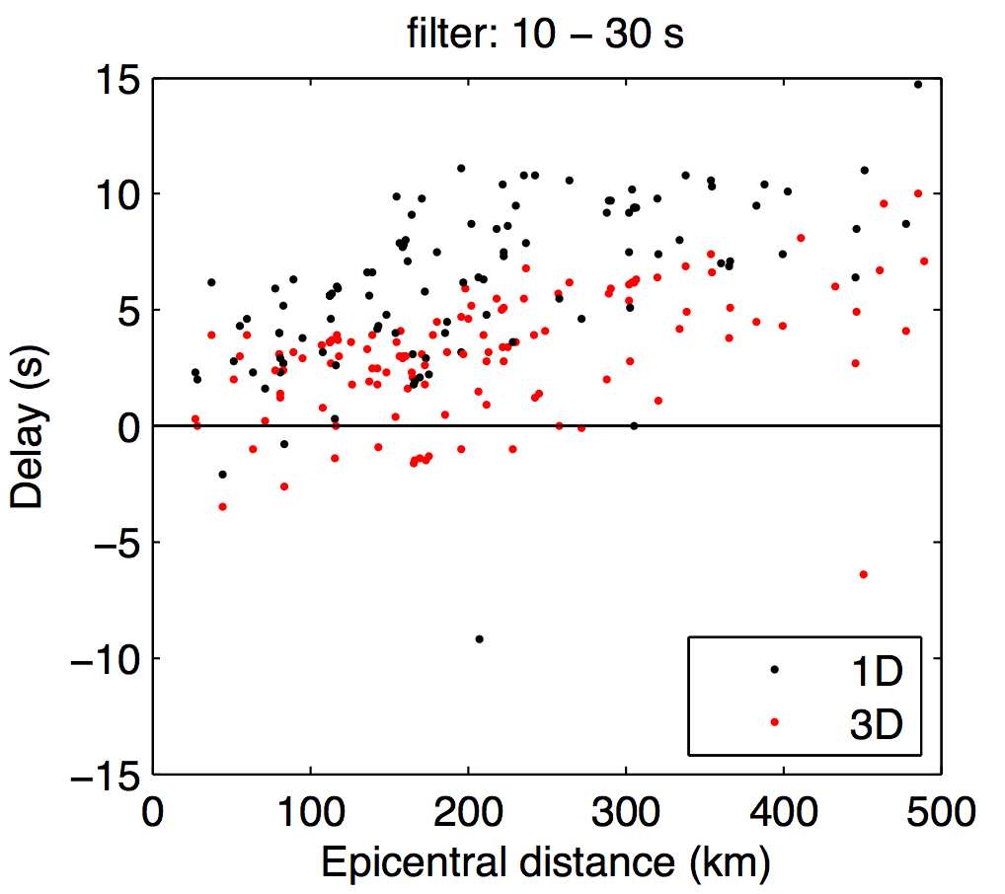
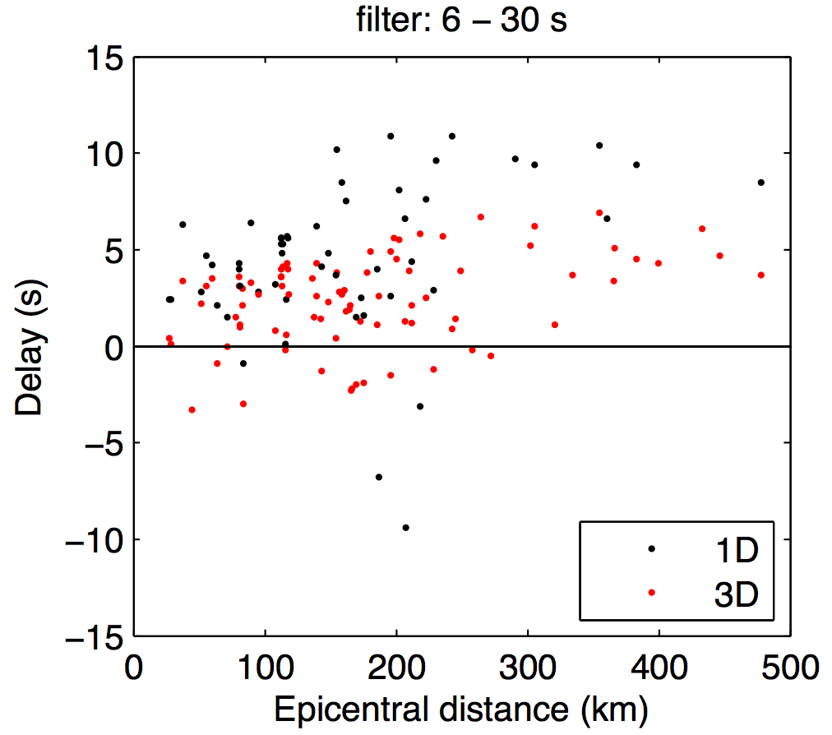
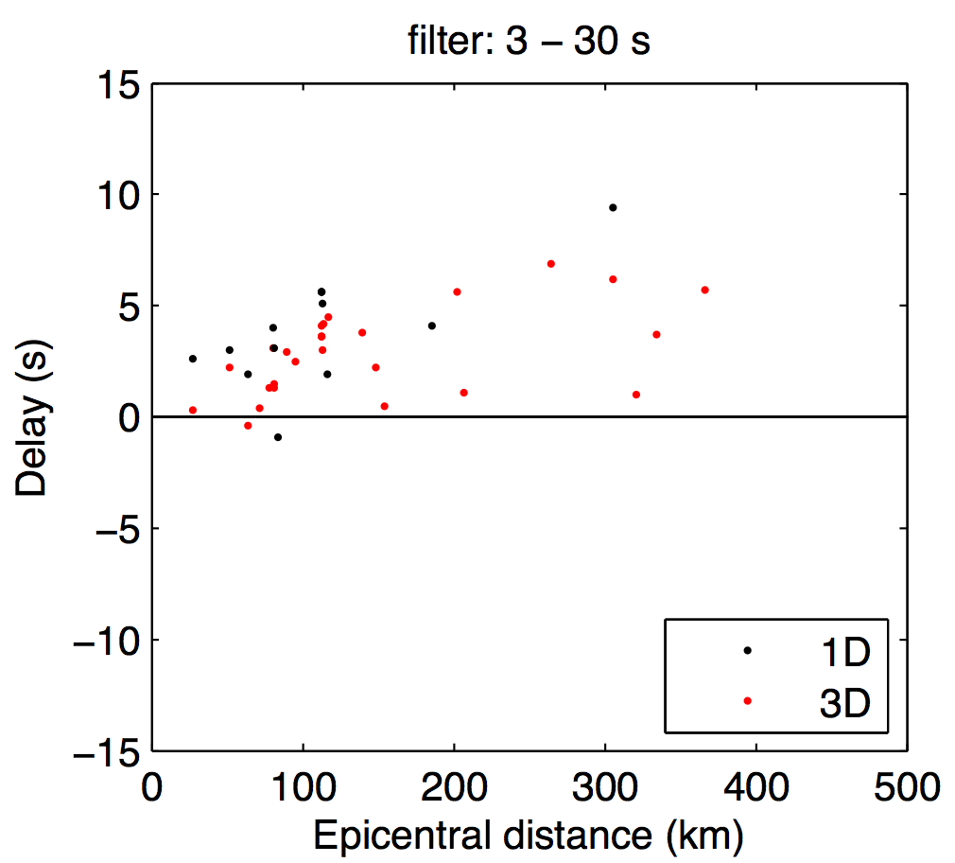
Quantitative validation
Plotting only CC > 0.7 (i.e., synthetics and data are similar)
A positive (linear) trend between phase delay and epicentral distance is observed
Positive trend is systematically observed for all three period bands
These results suggest that the actual velocity structure is slower (>15%) than the current 3D model

Slide 22
Quantitative validation
Plotting only CC > 0.7 (i.e., synthetics and data are similar)
A positive (linear) trend between phase delay and epicentral distance is observed
Positive trend is systematically observed for all three period bands
These results suggest that the actual velocity structure is slower (>15%) than the 3D model

Slide 23
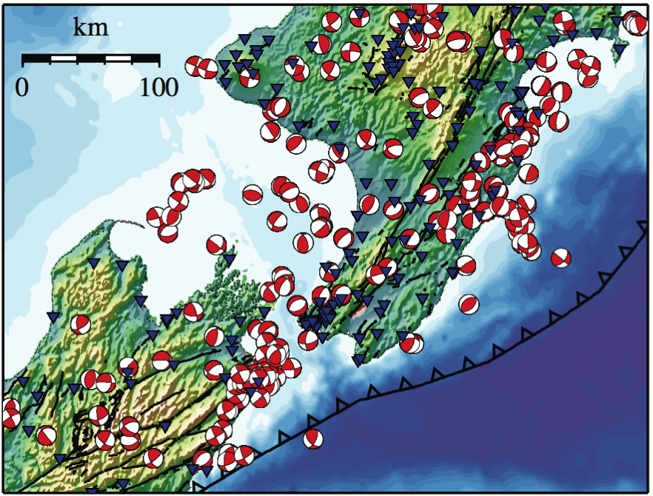
Conclusions
We have simulated seismic wave propagation within the latest 3D velocity model of North Island and assessed the accuracy of the model
Compared to the 1D model, the 3D model fits observed waveforms better
Yet, the 3D model appears to be systematically faster than the real structure
Future work
Include a latest 3D attenuation model and compare waveform amplitudes
Improve the 3D velocity model by performing full-waveform inversion (Tape et al., 2009; 2010)

Slide 24
Conclusions
We have simulated seismic wave propagation within the latest 3D velocity model of North Island and assessed the accuracy of the model
Compared to the 1D model, the 3D model fits observed waveforms better
Yet, the 3D model appears to be systematically faster than the real structure
Future work
Include a latest 3D attenuation (Q) model and compare waveform amplitudes
Improve the 3D velocity model by performing full-waveform inversion (Tape et al., 2009; 2010)

